Slide 1

INTRUSION DETECTION SYSTEM USING MACHINE LEARNING
Notes:
NOTE:
To change the image on this slide, select the picture and delete it. Then click the Pictures icon in the placeholder to insert your own image.

Slide 2
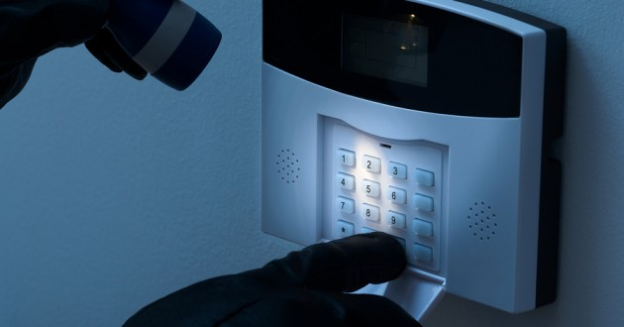
INTRODUCTION
Intrusion : Attempting to break into or misuse your system.
Intruders may be from outside the network or legitimate users of the network.
Intrusion can be a physical, system or remote intrusion.
Intrusion Detection Systems look for attack signatures, which are specific patterns that usually indicate malicious or suspicious intent.

Slide 3
WORK DONE!
Step 1
Network Dataset(KDD’99 dataset)
Step 2
Pre-Processing of Data
Step 3
Feature Extraction
Step 4
Training and Testing of Data
Step 5
Result Analysis

Slide 4
NETWORK DATASET (KDD’99 Dataset)
KDD Cup 1999 has 4,898,431 records in “train data set” & 311027 records in “test data set”
KDD data set has 41 features
Types of Attack
DoS – Denial of service
R2L – Remote to local attack
U2R – User to Root attack
Probe – Probing attack
Data Set | Normal | Probing | DoS | R2L | U2R
10% KDD | 97277 | 4107 | 391458 | 1126 | 52
Corrected KDD | 60593 | 4106 | 229853 | 11347 | 70
Whole | 972780 | 41102 | 3883370 | 1126 | 50

Slide 5
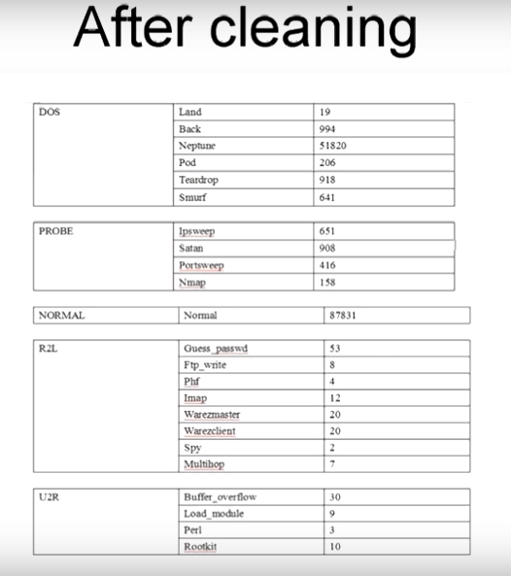
PRE-PROCESSING OF DATA
What is data cleaning?
Fill in missing values, smooth noisy data, identify or remove outliers and resolve inconsistencies.
What factors will be improved after pre-processing of data?
Accuracy
Integrity
Completeness
Validity
Consistency…

Slide 6
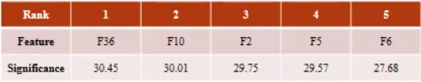
FEATURE EXTRACTION/ ENGINEERING
Example

Slide 7
MACHINE LEARNING CLASSIFIERS
We have used five classifiers in our model , they are
DECISION TREE
NAÏVE BAYES
K-NEAREST NEIGHBOR (KNN)
RANDOM FOREST CLASSIFIER
LOGISTIC REGRESSION
If you guys want , can add slides to explain the classifiers

Slide 8
TRAINING AND TESTING OF DATA
How are we training the model using KDD dataset?
How are we testing the data ?
What is a confusion matrix?
What are the result parameters that measure our model’s performance?

Slide 9
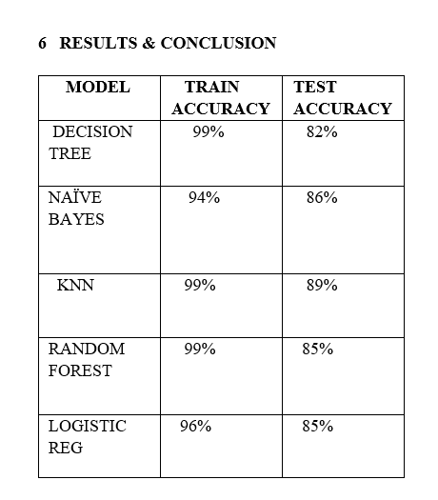
RESULTS

Slide 10
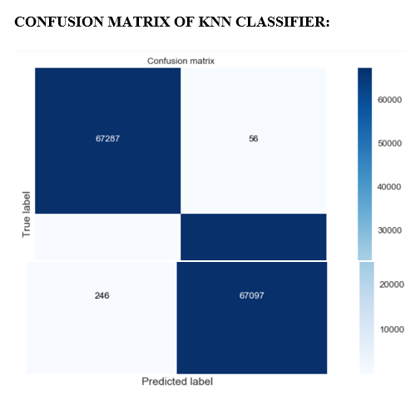
RESULTS

Slide 11
CONCLUSIONS
INTRUSION DETECTION APPLICATION:
An Intrusion detection application is developed from the knn model, flak front end, HTML, CSS and java script. So, when a new file which contains the details of a network is given to the intrusion detection application, it will be able to detect weather the network is malicious or normal.

Slide 12
THANK YOU ☺

